Slide 1
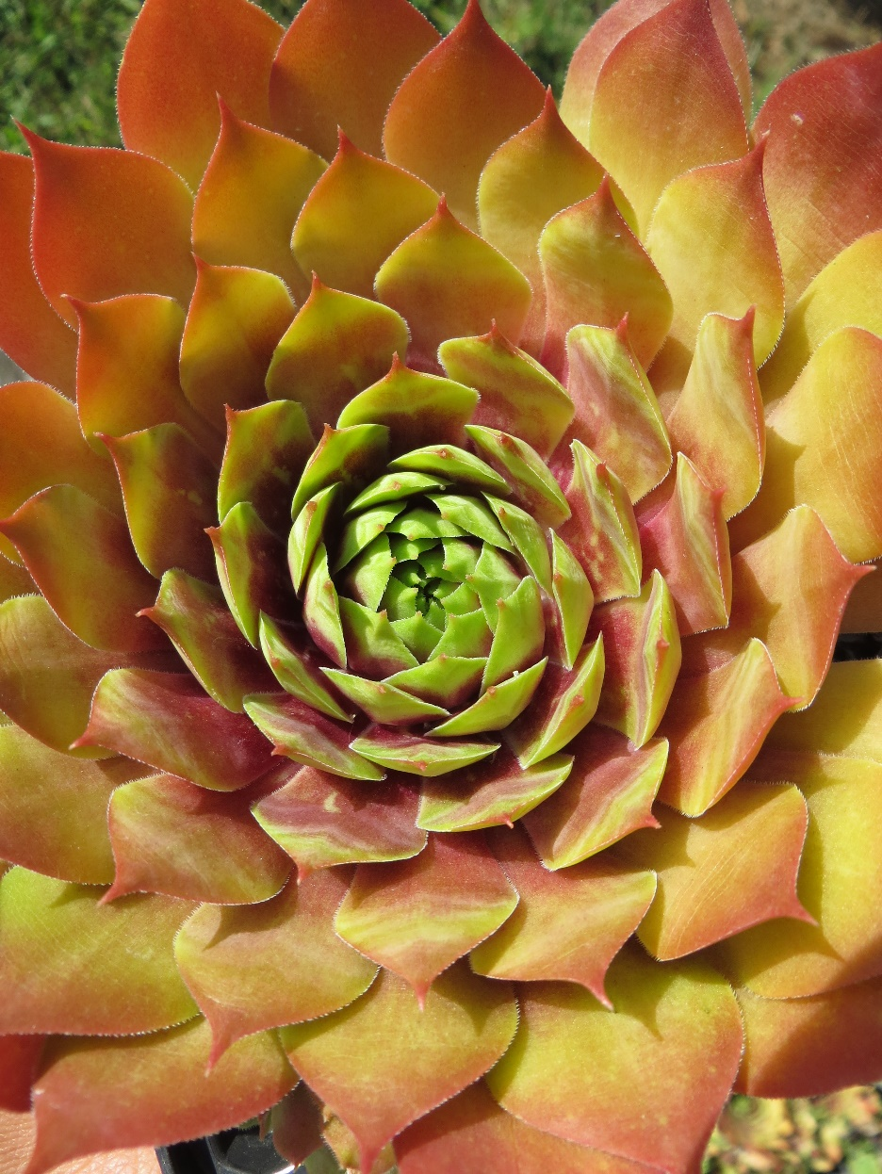
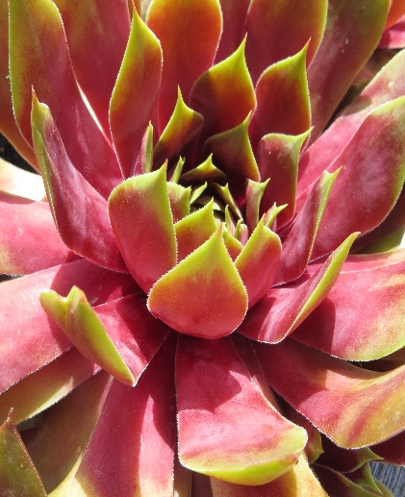
SUPERSEMPS™ SEMPERVIVUM AMBER
KEY FEATURES
Sempervivum ‘Amber’ belongs to the amazing new range of SUPERSEMPS™, bred in Germany
‘Amber’ colours up intensely with cold temperatures, taking on slightly different hues as the temperature fluctuates
Forms perfect, extra-large, symmetrical rosettes up to 20cm diameter
Clusters of pink star-shaped flowers appear in mid to late summer
Outstanding when mixed with contrasting-coloured succulents, but equally outstanding featured alone!
Drought, wind and cold tolerant (if kept dry)
Place in full sun for the most intense colour
20cm wide x 12cm high

