Slide 1
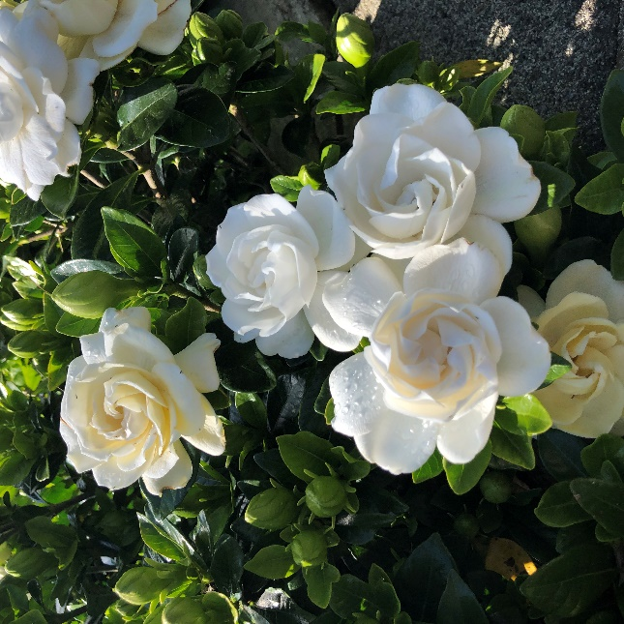
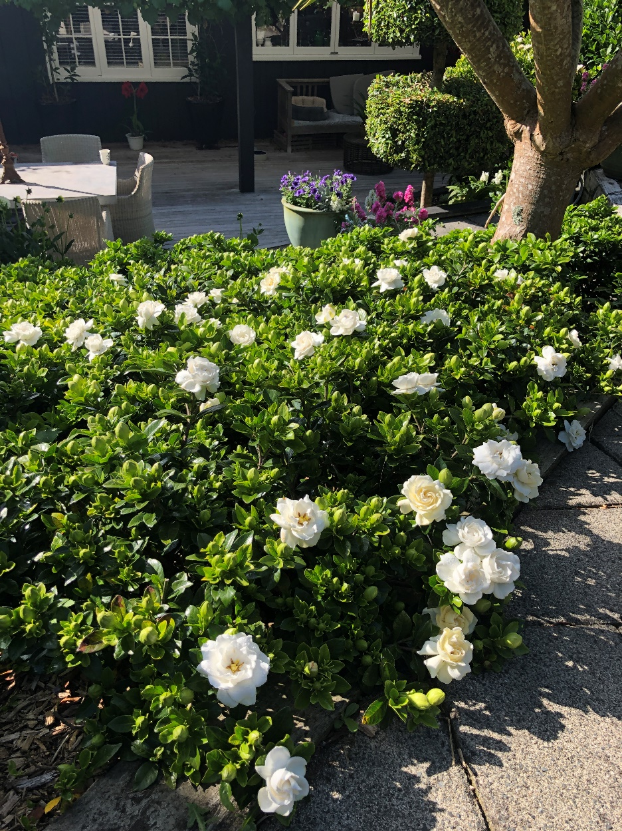
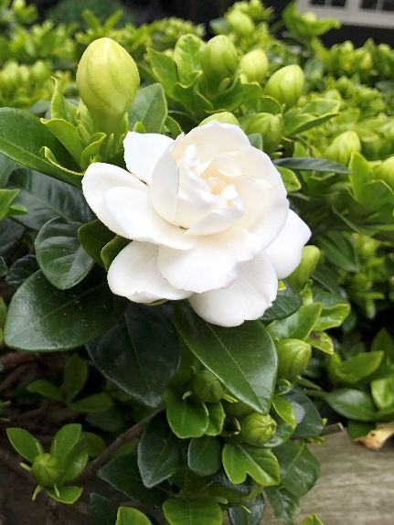


GARDENIA CROWN JEWEL PVR30920
KEY FEATURES
Year-round appeal from healthy dark green foliage and sumptuous blooms
Delicate pure white flowers mature to rich cream
Mass flowering in summer followed by a second flush in autumn!
Intensely fragrant blooms fill the warm evening air with the most delectable scent
Excellent as a low hedge, mass planted, or in containers by a doorway to take advantage of the gorgeous scent
Extremely cold hardy to -18°C
0.75m x 0.75m

